Slide 1
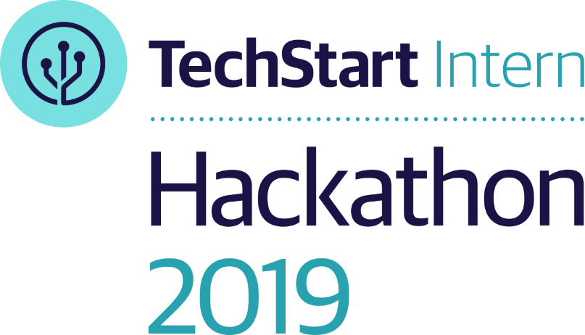
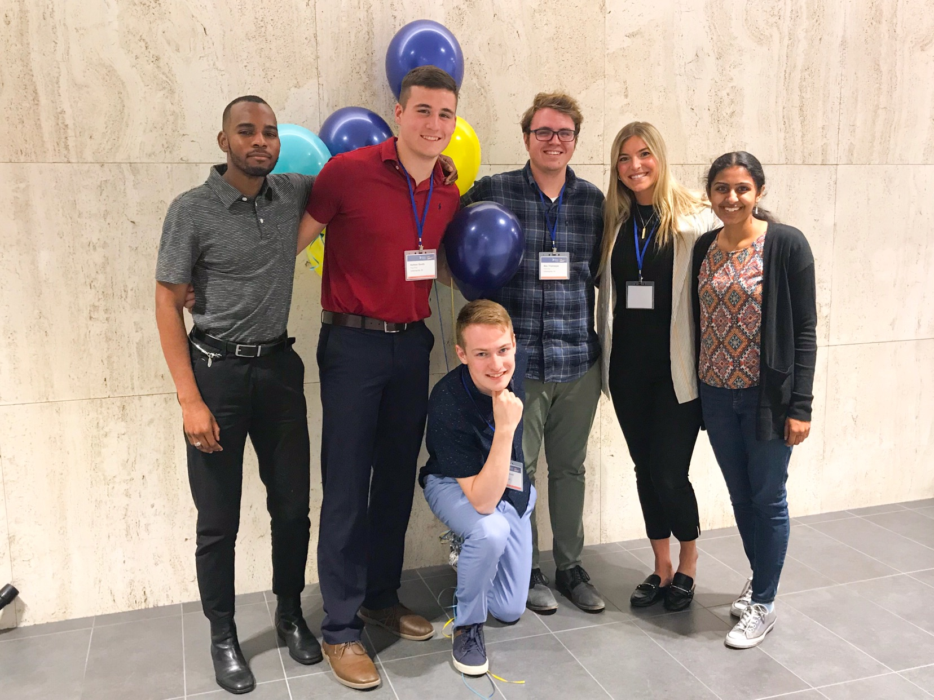
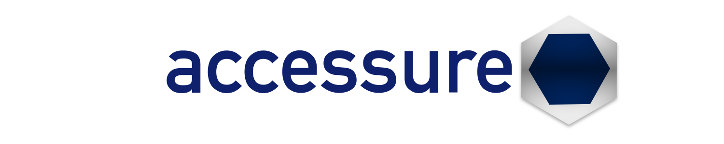
Pixel Pals
Gregory Harris, Sachi Nutulapati, Claire Contos Emanuel Pituch, Ashton Smith, Max Thielmeyer

Slide 2
Our Purpose
Our Goal
To create a performance measurement to improve the overall accessibility for all Liberty Mutual employees and users with visual, auditory, motor, or cognitive impairments.
We want to improve and accelerate the process of how developers, testers, and engineers design, develop, and deliver code that caters to employees and users who have accessibility needs.

Slide 3
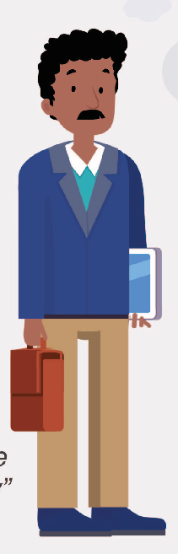
Persona 1 – Color Blindness
Noah's Symptoms -
Some colors appear different to him (red/green)
Not able to differentiate pop-up messages such as errors, tips and requirements
Accessibility Solutions -
All color combinations should have a contrast ratio of at least 4.5:1 for normal-size text
Instead of color, use symbols, outlines, bolded text, shapes etc.
Noah's Alternative Solutions -
Relies on text, symbols, and images to understand context and content
"I often feel like I completely miss the point of a website, so I don't feel valuable as a customer to that company"

Slide 4
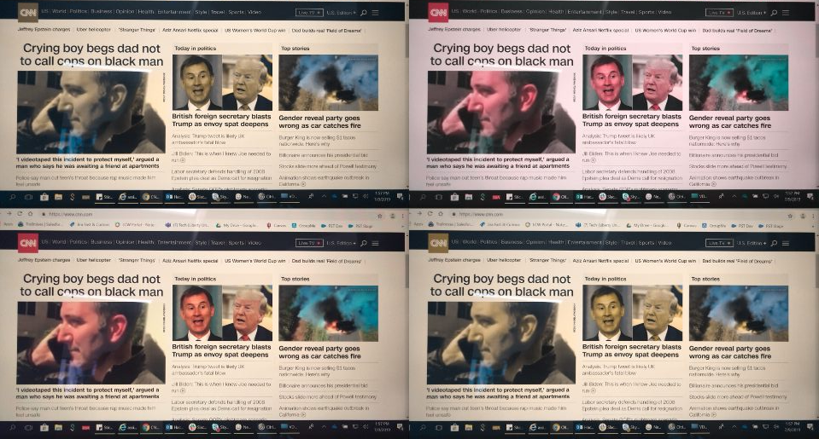
Persona 1 - Color Blindness

Slide 5
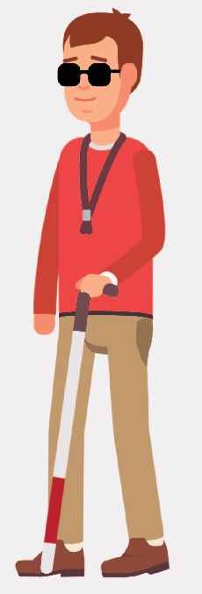
Persona 2 - Blindness
Accessibility Solutions -
Improve screen reader experience
Every image has appropriate alternative text
interactive audio experience - users who file a claim via mobile could do it just by audio and not type everything out – not just a disability perspective –
Every form control has a label associated with it
Labels are positioned correctly on the form
David's Symptoms -
No vision
David's Alternative Solutions-
Navigating websites using screen readers – not intuitive or user-friendly
"I feel like I am missing much of what other users get to experience, but I will take what I get"

Slide 6
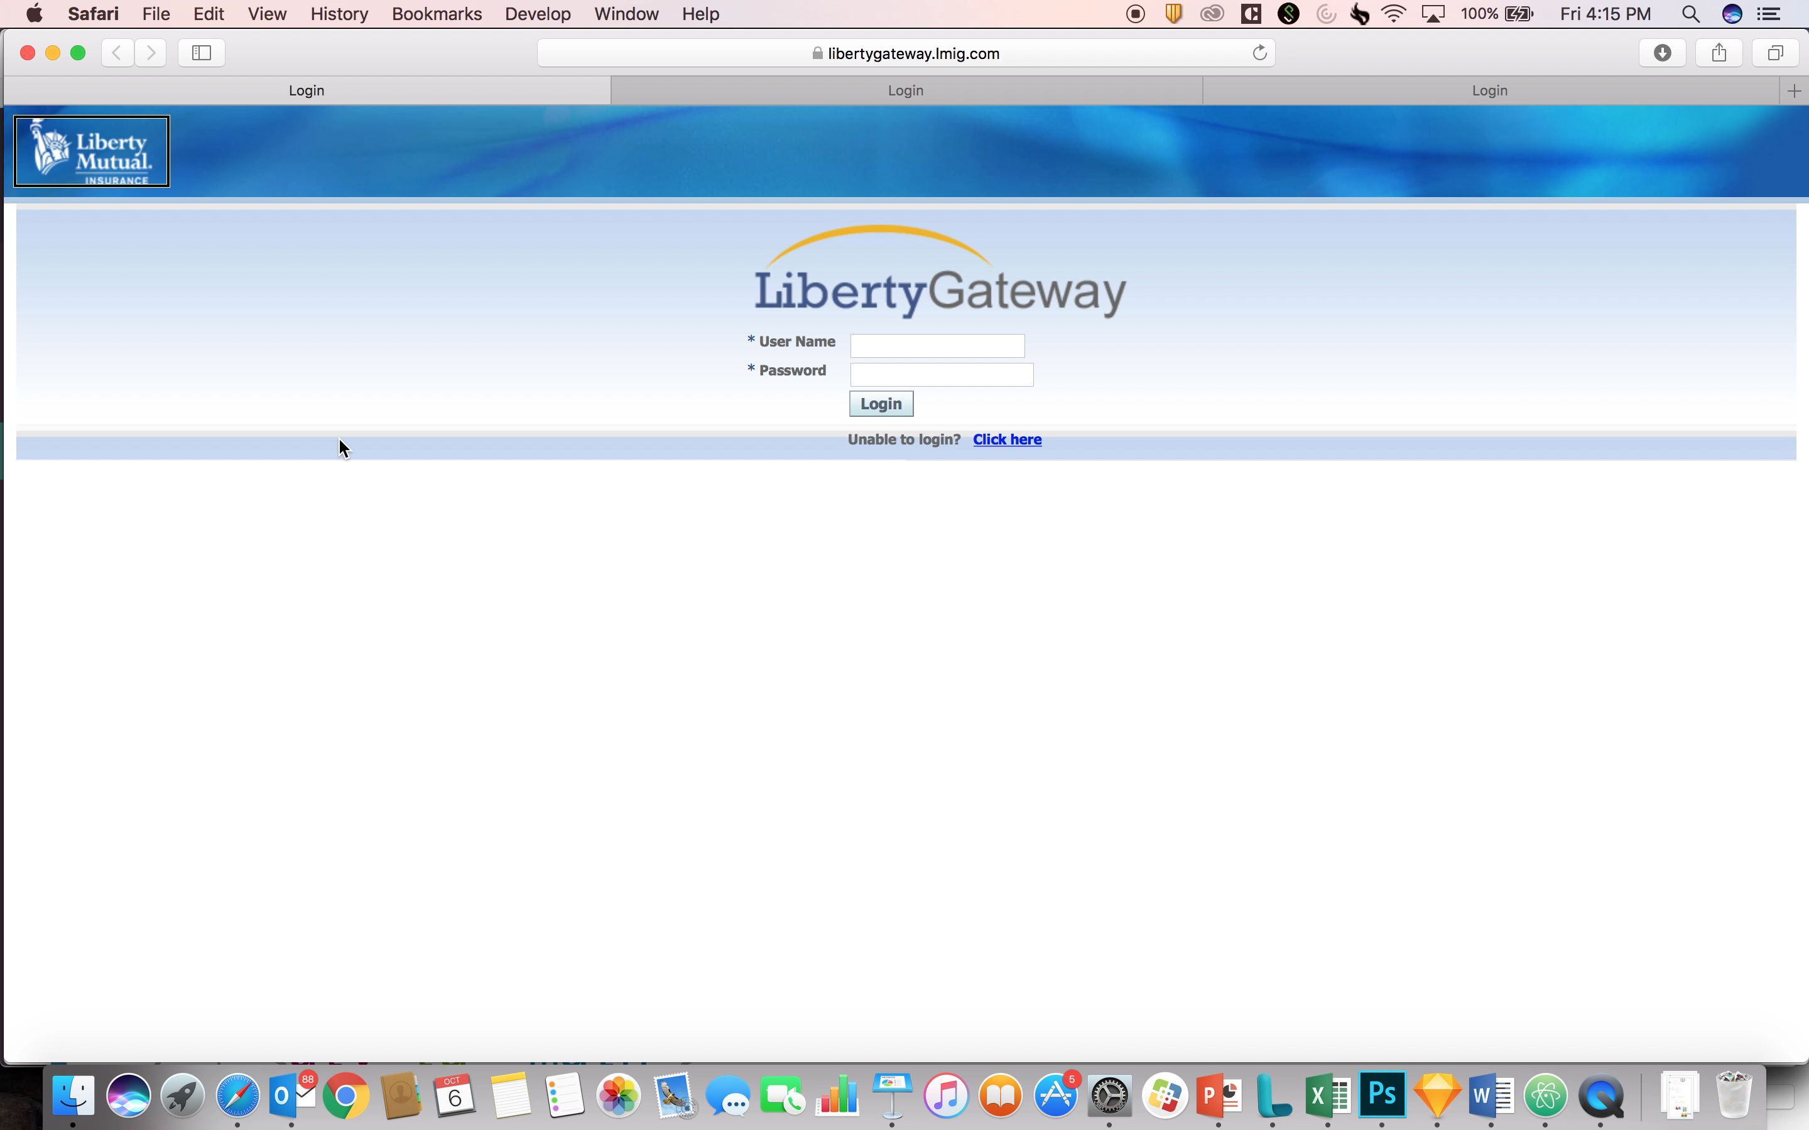

Slide 7
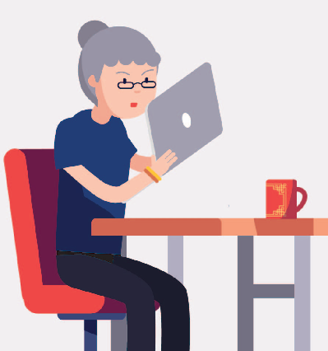
Persona 3 - Visual Impairment
Jane's Symptoms:
Has low vision
20/200 vision
Hard to see details
Lots of visual distractions
Accessibility Solutions -
All text gets larger
Text doesn't disappear or get cut off when zooming
Horizontal scrolling is not required to read sentences
Responsive Solutions
Jane's Alternative Solutions:
Zoom text on browsers
Magnifies applications
Use Screen Readers – auditory
"An application will be completely useless to me if I cannot zoom the text"

Slide 8
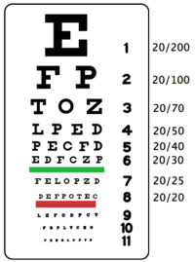
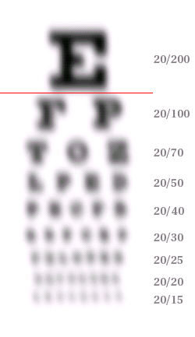
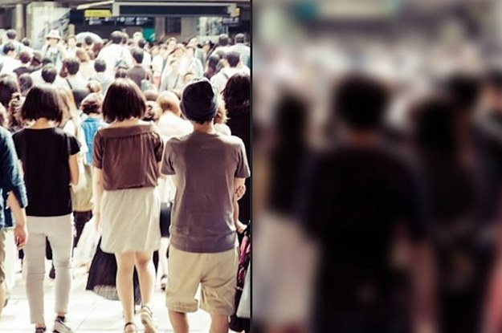
Persona 3 – Visual Impairment
What a regular person would see
What Jane would see: 20/200 Vision

Slide 9
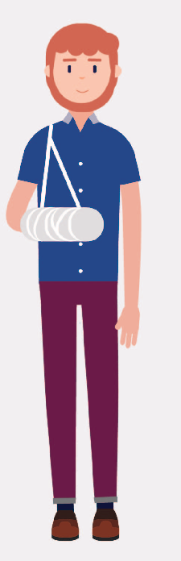
Persona 4 - Motor Impairments
Rob's Symptoms:
Limited movement in some body parts, unable to use a mouse
Rob's Alternative Solutions
Using the keyboard to navigate
Screen reader
Accessibility Solutions
Ability to tab to & away from all functionalities
Page provides logical tab order
Visual focus is obvious & clear
"I still have to get my job done even though I broke my wrist and it seems impossible"

Slide 10
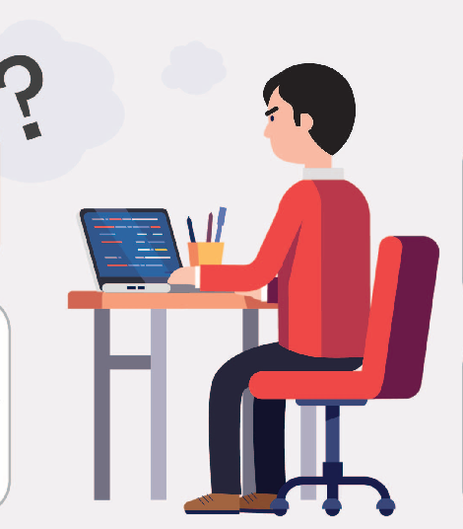
Persona 5 - Cognitive
Mike's Alternative Solutions:
Takes longer to process information, too much information or patterns can be overwhelming
Accessibility Solutions
Page provides only 1 heading
All text that looks like a heading is marked up as a heading/ is a conceptual section heading
Page provides meaningful heading hierarchy
Mike's Alternative Solutions:
Take breaks or short visits when viewing websites, text-only versions, or requires assistance from someone to navigate or interpret the website
"I just want to be able to understand what everybody else can understand"

Slide 11

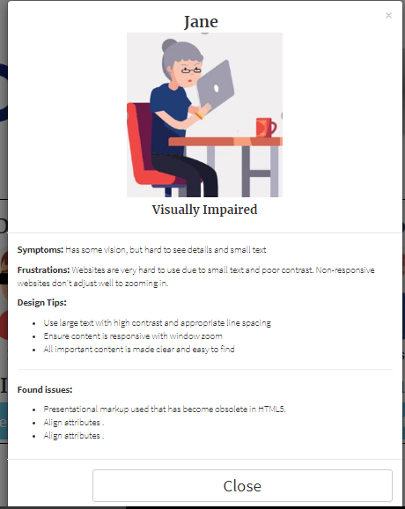
Opportunity
Solves the problem of holding a higher regard for developing with accessibility in mind. Customers will appreciate this new developmental practice because it is a integral foundational step for reaching all customers needs.
Solution
Our solution has the key features of innovation, progress, and empathy. This allows the developer to create understanding for those with accessibility needs.
Benefits
For our customers, the benefits include an inclusive & improved interface that appropriately fits their needs.
For the company, the benefits include an evolved process for generating feedback for their user's expereince.
Solution Overview

Slide 12
Demo Time!

Slide 13


Questions
Comments

